Slide 1
Introduction to Algorithms
(and Data Structures)
Introduction

Slide 2
Introduction
Lecturer
Name Shane Mulligan.
Web Site: www.comp.dit.ie/smulligan/dt211.html
Email: shane.mulligan@dit.ie not on web site.

Slide 3
Introduction
Textbook References
  Most textbooks are not suitable for 1st year.
  Many textbooks on Algorithms.
Algorithms in C, Robert Sedgewick.
Algorithm Design, Goodrich and Tamassia.
Introduction to the Design and Analysis of Algorithms, Anany Levitin, Addison Wesley.
Lectures/ Notes will contain most of the necessary material. Students are expected to attend all lectures and tutorials.

Slide 4
Introduction
Course Assessment
  Continuous assessment 40%
    Labs 10% approx.
    Class tests 20% approx.
    Assignment 10% approx.
  Examination 60%
    Attendance will be taken
  Tutorials & Labs - 4 Groups
  Continuous assessment done in labs & tutorials during semester.

Slide 5
Introduction
Course Outline
Data and Data types
Algorithms – Pseudocode & flowcharts
  Representing algorithms
  Basic Algorithm constructs
      Sequence
      Selection
      Repetition
  Writing Pseudocode
  Writing Flowcharts
  Typical sample algorithms

Slide 6
Introduction
  Basic data structures.
  Arrays 1D and 2D
  Linked lists
  Stacks
  Queues
  Trees
  Binary search trees
Descriptions and applications of these.

Slide 7
Introduction
Analysis of algorithms
  Complexity, big-O notation.
Sorting algorithms.
  Elementary sorts, more advanced sorting.
  Complexity analysis.
Searching algorithms.
  Binary search trees, general trees.

Slide 8
Introduction -- Algorithms
A computer (system) is a data processing machine. A simple model of a computer is shown as follows.
Computer processes data to produce information.
Input data may/may not be intelligible to humans, e.g. barcodes, but the processed information should be meaningful to humans, e.g. the product description.
Input Data
Processor
Process Data
Output Data / Information.

Slide 9
Introduction -- Algorithms
Computers process data using computer programs to carry out specific tasks.
These programs are built using Data Structures and Algorithms.
Data Structures are the means that data can be stored and manipulated in a suitable way by computer programs. These may be simple or may be more complicated.
Algorithms describe the set of instructions that must be carried out to solve a particular problem or task. These may also be simple or quite complicated depending on the problem.

Slide 10
Introduction -- Algorithms
Data. A basic problem is to understand how data is stored in a computer. This is necessary to understand, in order to create efficient and useful algorithms.
Representing and Storing Data.
  All data stored in a computer is represented in binary form. This means that only 2 distinct symbols (signals) need to be recognised. We denote these numerically by 0 and 1. We call numbers in this form base 2 numbers, or binary numbers.

Slide 11
Introduction -- Algorithms
Our usual number systems uses base 10, i.e. we have 10 different symbols to recognize: 0, 1, 2,…, 9.
Basic unit of computer storage is the bit (1 binary digit = 1 bit)
1 Byte = a set of 8 bits, stored together.
1 Word = set of 4 bytes or 32-bits.
Sometimes 1 Word or a Long Word = 8 bytes or 64 bits.

Slide 12
Introduction -- Algorithms
Computer memory (RAM) is usually accessed or located using 32-bits. This is because a large amount of memory needs many bits to specify every location.
Using 32 bits we can access or address 2³² memory locations. This is a large number, about 4.3 billion locations.

Slide 13
Algorithms
Definition. An algorithm is a finite set of instructions that specify a sequence of operations to be carried out in order to solve a specific problem or class of problems.
An algorithm must have the following properties:
Finiteness: Algorithm must complete after a finite number of instructions have been executed.
Uniqueness: Each step must be clearly defined , having only one interpretation.
Definition of sequence: Each step must have a unique defined preceding and succeeding step. The first step (start step) and last step (halt step) must be clearly noted.

Slide 14
Algorithms
Input/output: There must be a specified number of input values, and one or more result values.
Feasibility: It must be possible to perform each instruction.
As an example consider the following simple algorithm.
1. x := a
2. if b > x, then x := b
3. if c > x, then x := c
which finds the maximum of 3 numbers a,b,c.

Slide 15
Algorithms
Idea is to inspect the numbers one by one and copy the largest value seen into x.
At the end of algorithm, x will then be equal to the largest of the 3 numbers.
The := is the assignment operator, i.e. copy value of a into x.
In C it is just = operator.
Example. pi = 3.14159
Examples. x:= 5, pi := 3.1425

Slide 16
Algorithms
We show how the algorithm executes for some specific values of a,b and c.
Such a simulation is called a trace or dry-run. Suppose that a=1, b=5, c =3.
At line 1, set x to 1, At line 2 we set x to b=5, 5 > 1.
At line 3, c > 5 is false, so do nothing.
So now x = 5 , largest of (1,5,3).
Suppose that a = 6, b = 1, c = 9, then trace the algorithm.
Note that our example algorithm has the properties set out earlier.

Slide 17
Algorithms
Algorithm has the properties set out earlier.
  The algorithm stops after finitely many steps giving the result.
  Given values of the input each step of the algorithm produces a unique result.
  There is a definite sequence of steps.
  The algorithm receives input and produces output. It receives input a,b,c and produces output, max value x.
  The steps are feasible.

Slide 18
Algorithms
Exercises:
Write an algorithm that finds the smallest element of a,b,c.
Write an algorithm that finds the second largest element among a,b and c.
Write the standard method of adding 2 positive integers, taught in primary school, as an algorithm.

Slide 19
Algorithms
Notation for Algorithms.
Ordinary language is sometimes used, but many computer scientists prefer Pseudocode, because of its precision structure and universality.
Pseudocode is so named because it resembles the actual code (programs) of languages such as Pascal and C. Many versions of pseudocode. Unlike actual computer languages, any type of pseudocode is acceptable, as long as its instructions are unambiguous and it resembles in form, if not in exact syntax the language used (or pseudocode here).

Slide 20
Algorithms
As first example of pseudocode, we rewrite the algorithm which finds the max. of three numbers.
Algorithm 1. Finding the Maximum of 3 numbers.
Input : Three numbers a, b, c
Output : x, the largest of a, b and c.
1. max(a,b,c) // the algorithm name
2. x := a
3. if b > x then // b is larger than x, update x
4. x := b
5. if c > x then // c is larger than x, update x
6. x := c
7. return (x)
8. end max

Slide 21
Algorithms
Our algorithms consist of a title, a brief description, the input and output, and the procedures containing the instructions, here a single procedure.
The first line contains the algorithm name, and then in brackets the parameters supplied to the procedure. In line 7 we return the value of x, the largest of the numbers.
The last line consists of the word “end” followed by the algorithm name.

Slide 22
Assignments
Simplest statement is the assignment, giving a value to a variable (data item).
Variable is a user-defined name that holds data item.
  x := 5
  pi := 3.14159
  Name := “john”, etc
  So assignments look like:
  variable := data / variable / expression

Slide 23
Assignments
Consider the simple example.
length := 5.2
width := 6.3
area := length * width
perimeter := 2*length + 2*width
Here the variables are chosen to be self-explanatory.
The variable must be on the LHS.
You should always do this if possible.

Slide 24
Assignments
Assignments are used to:
Initialise values to variables.
Assign constant values.
Compute expressions, e.g. math formulas, using other variables or constants.
Example:
pi := 3.14159
radius := 2
Area := pi*radius*radius

Slide 25
Types of Statements
There are basically three types.
  Sequence.
  Selection (decisions)
  Iteration (repeating statements)
Our simple algorithm used selection (if statement)
If statements are used to make decisions. The decision is based on something being TRUE or FALSE.
if b > x, then x := b
if c > x, then x := c
If b > x is TRUE then x is changed to value of b.

Slide 26
Selection – If
If statements are used to make selections.
There are three main types.
1. If condition then statement, or
  If condition then // write a comment here
  statement(s)
  end if
  If a < b then // if this is true (this is a comment)
  small := a
  end if

Slide 27
Selection – If
2. If condition is true or false then different action.
  If condition then // condition is true
  statement(s)
  else // condition is false
  statement(s)
  end if
  If a < b then
  smaller := a
  else
  smaller := b
  end if

Slide 28
Selection – If
3. If statement with several different conditions.
  If condition1 then // condition1 is true
  statement(s)
  else if condition2 then // condition2 is true
  statement(s)
  else if condition3 then // condition3 is true
  statement(s)
  ….
  else
  statement(s)
  end if
Most often we use type 1 or 2 If statements.

Slide 29
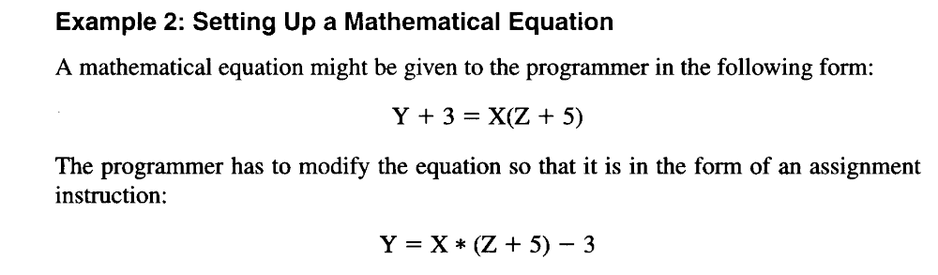
Example

Slide 30
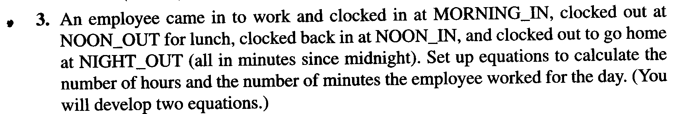
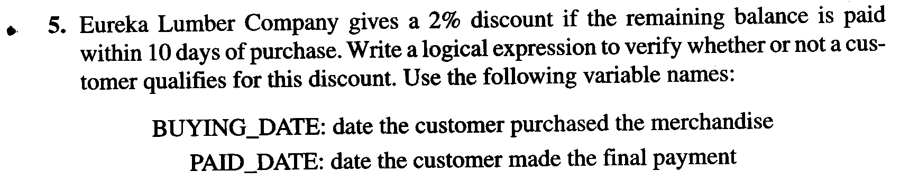
Exercises

Slide 31
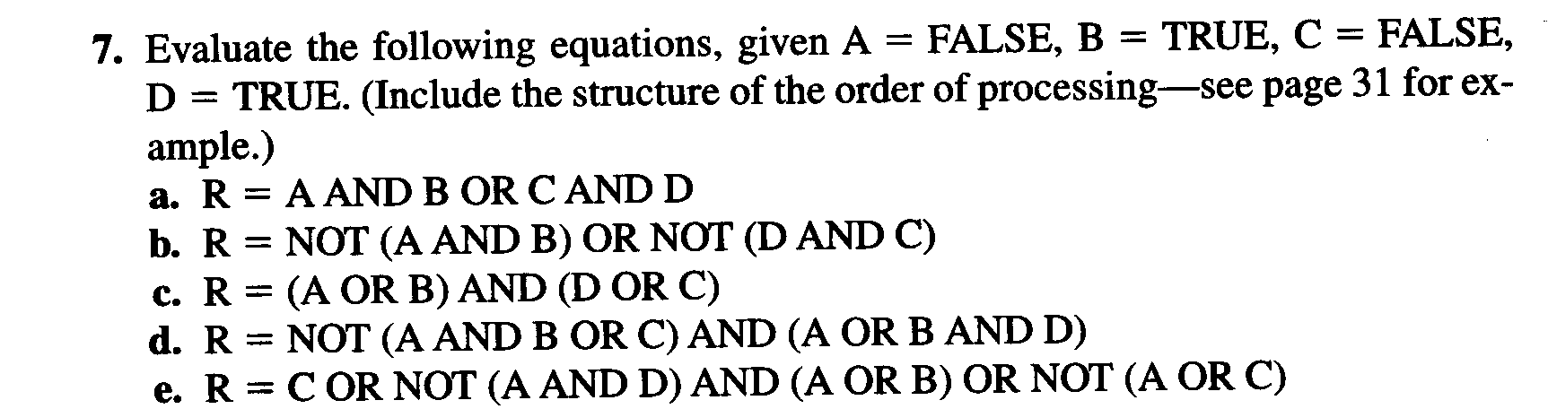
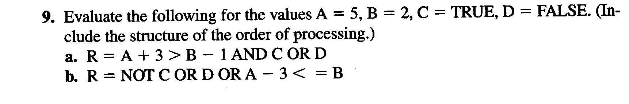
Exercises

